Slide 1
Capstone Engagement
Assessment, Analysis, and Hardening of a Vulnerable System

Slide 2
Table of Contents
This document contains the following sections:
01
Network Topology
02
Red Team: Security Assessment
03
Blue Team: Log Analysis and Attack Characterization
Hardening: Proposed Alarms and Mitigation Strategies
04

Slide 3
Network Topology
‹#›

Slide 4
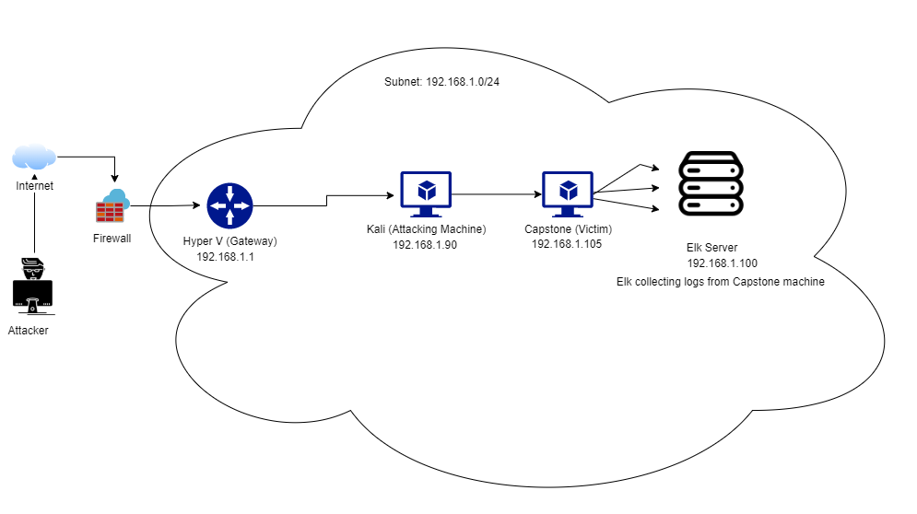
Network Topology
Network
Address Range:192.168.1.0/24
Netmask: 255.255.255.0
Gateway:192.168.1.1
Machines
IPv4:192.168.1.90
OS: Linux
Hostname:Kali
IPv4: 192.168.1.105
OS: Linux
Hostname: Capstone
IPv4: 192.168.1.100
OS: Linux
Hostname: Elk

Slide 5

Red Team
Security Assessment
‹#›

Slide 6
Recon: Describing the Target
Nmap identified the following hosts on the network:
Hostname | IP Address | Role on Network
Kali | 192.168.1.90 | Machine used to Attack.
Capstone | 192.168.1.105 | Machine acted as Target/Victim.
Elk | 192.168.1.100 | Logs collection from capstone
Hyper-V Manager | 192.168.1.1 | Gateway

Slide 7
Vulnerability Assessment
The assessment uncovered the following critical vulnerabilities in the target:
Vulnerability | Description | Impact
Open Ports | Port 80 , 22 on target machine was open . | TCP-80 allowed the attacker to explore through HTML web pages of the server.
Open Directory | Presence of secret folder on web server allows an attacker to further carry the attack | Information about the potential entities was obtained such as personnel dealing with secret folder.
Simple Data | Sensitive information displayed in simple plain text | Data could be well understood as set in simple English language
Weak Credentials | Easy passwords subjected to attacks. | Leopoldo, linux4u – easy passwords that were easily brute forced.

Slide 8
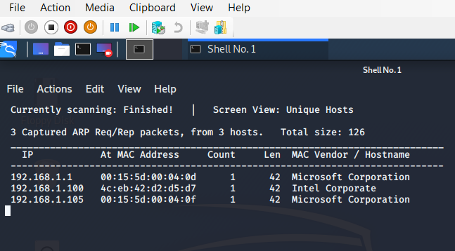
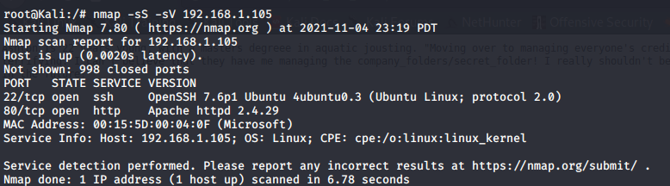
Exploitation: [Web Server]
01
02
03
1
Tools & Processes
Netdiscover & Nmap was used to scan for existing vulnerabilities
Commands used:
Netdiscover –r 192.168.1.0/24
Nmap –sS –sV 192.168.1.105
Achievements
It displayed 2 open ports: SSH 22 & TCP 80, and facilitated to explore more into website through port 80, and also granted access to ssh through port 22.
2

Slide 9
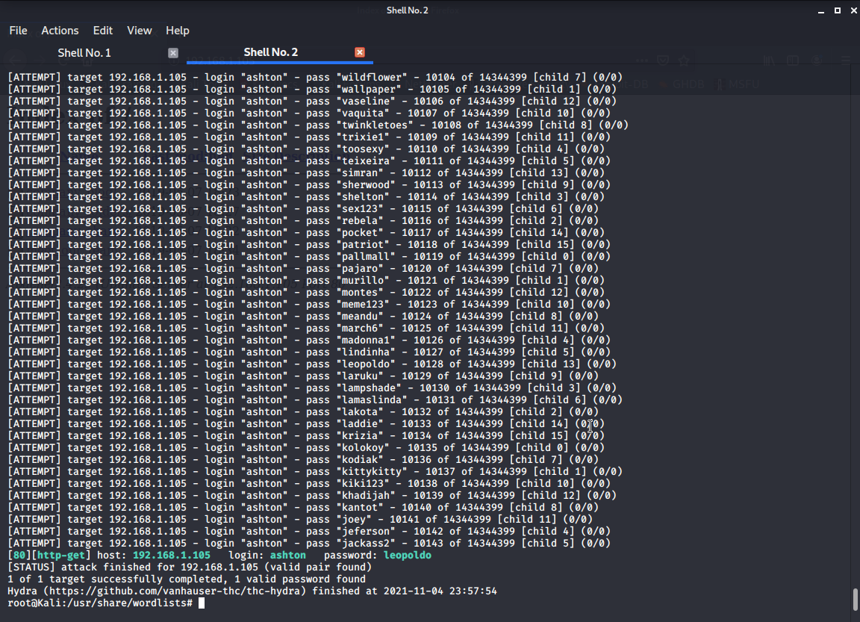
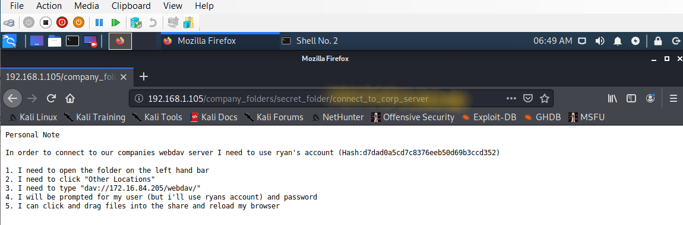
Exploitation: [Brute Force Attack]
01
02
03
Tools & Processes
Hydra was used to brute force the password file.
Command used: hydra –l ashton –P /usr/share/wordlists/rockyou.txt –s 80 –f –vV 192.168.1.105 http-get “/company_folders/secret_folder”
Achievements
An access to hidden folder was obtained that further directed to connect to the company’s server.
2
3
1

Slide 10
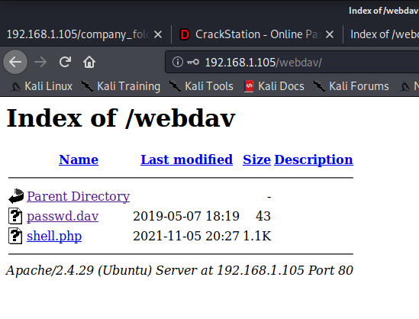
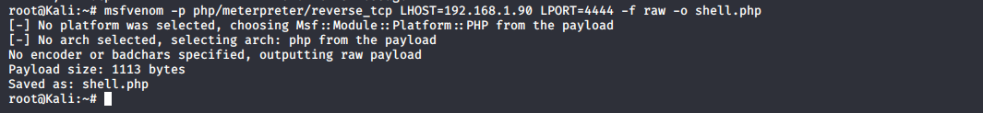
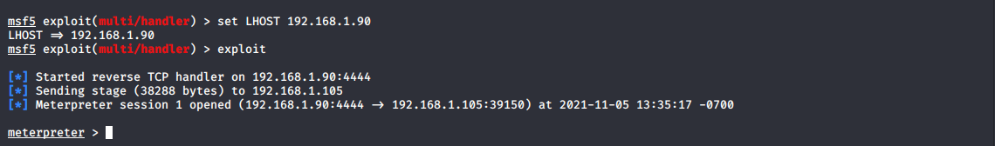
Exploitation: [Webdev]
01
02
03
Tools & Processes
Msfvenom was used to create the php payload to load into target machine.
Metasploit tool used to exploit.
3
Achievements
/bin/bash, interactive shell was granted.
Reverse shell was successfully created and meterpreter session established.
1
2

Slide 11

Blue Team
Log Analysis and Attack Characterization
‹#›

Slide 12
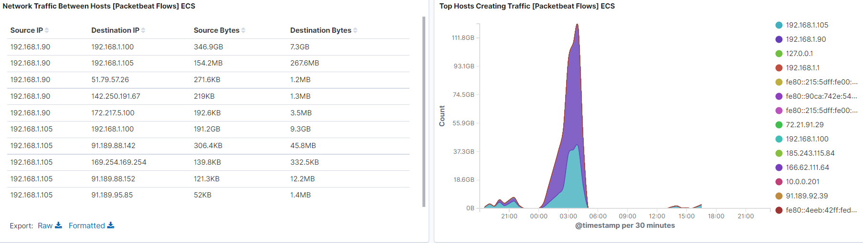
Analysis: Identifying the Port Scan
Traffic b/w Hosts
Top Hosts Creating Traffic
Port Scan Occurred at 7 pm , 2021-11-04
154.2 MB packets were sent from 192.168.1.90
Peak is an indicative of port scan

Slide 13
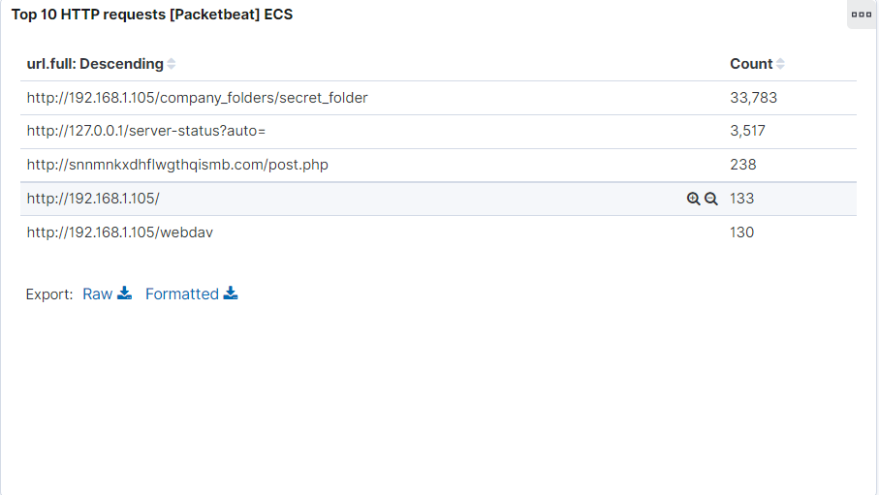
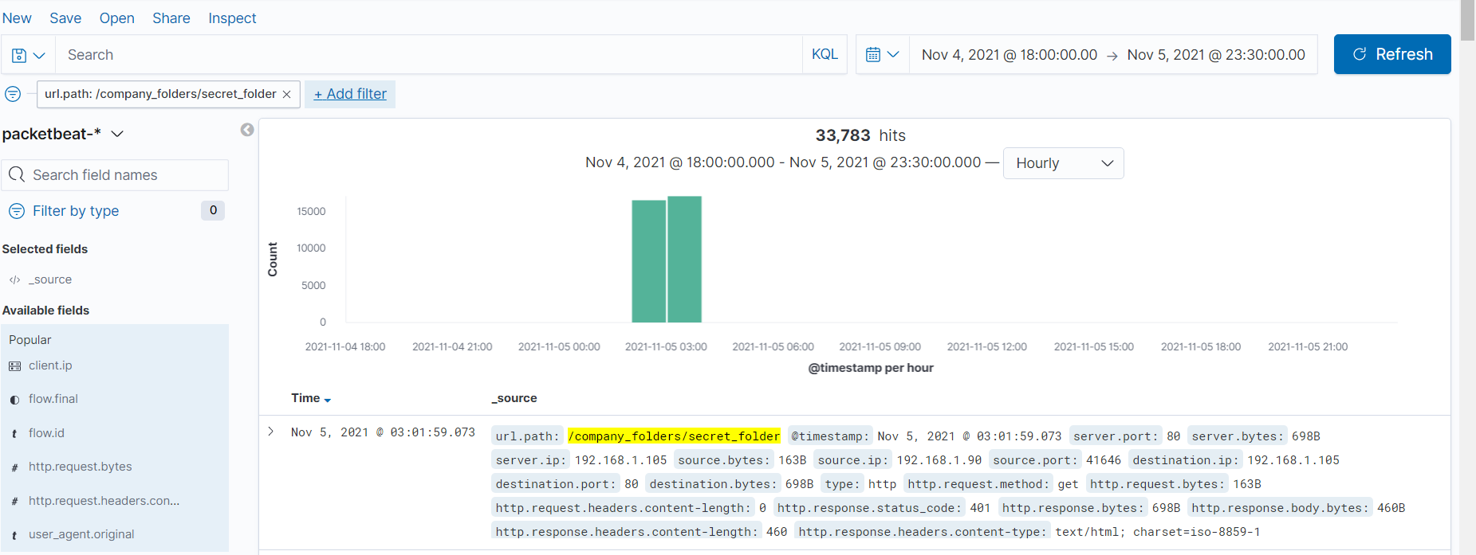
Analysis: Finding the Request for the Hidden Directory
HTTP Requests for Secret Folder
2021-11-05 3:01 is the time and 33,783 requests were made.
The file contained the information about connecting to Corp server.

Slide 14
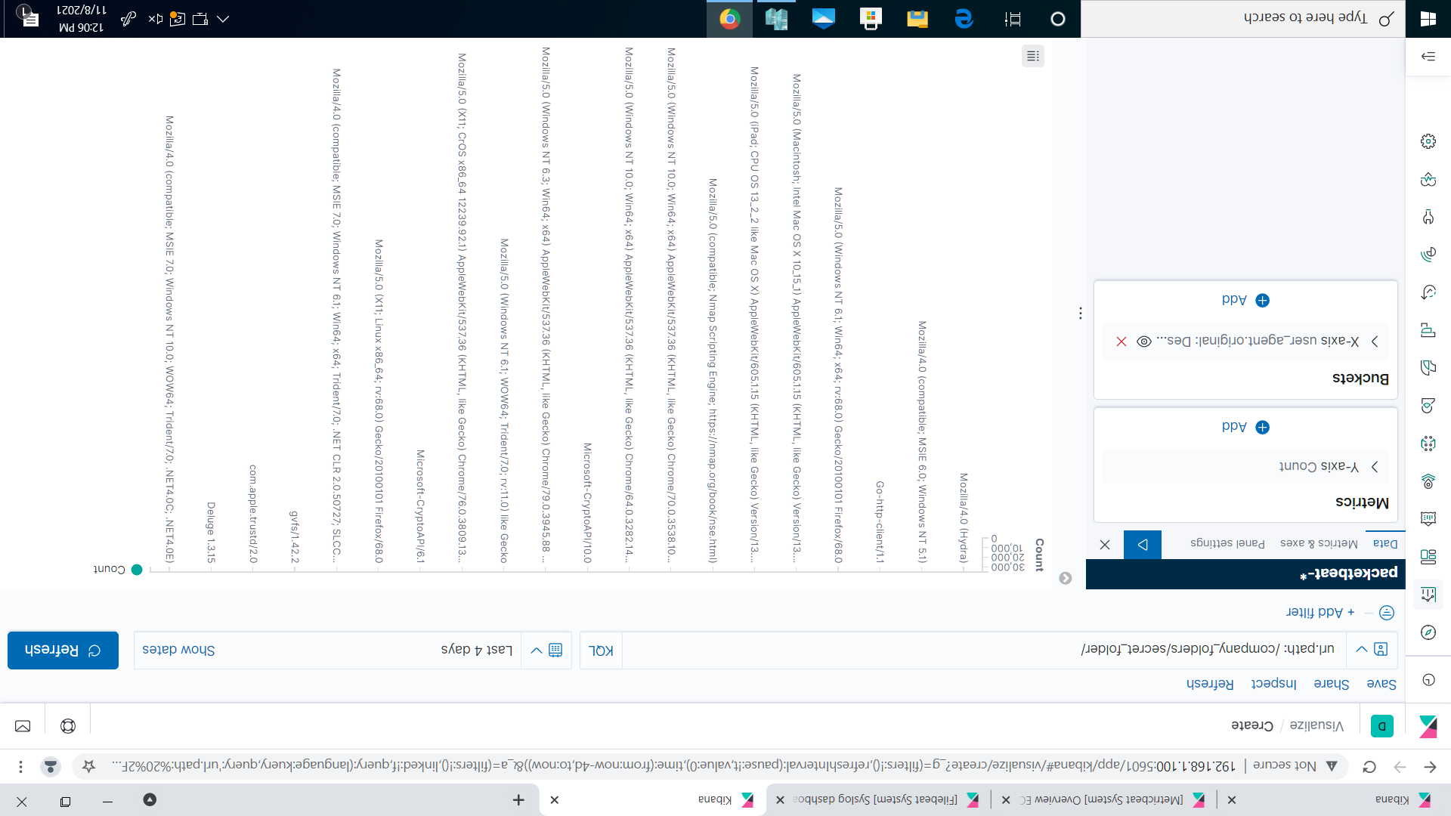
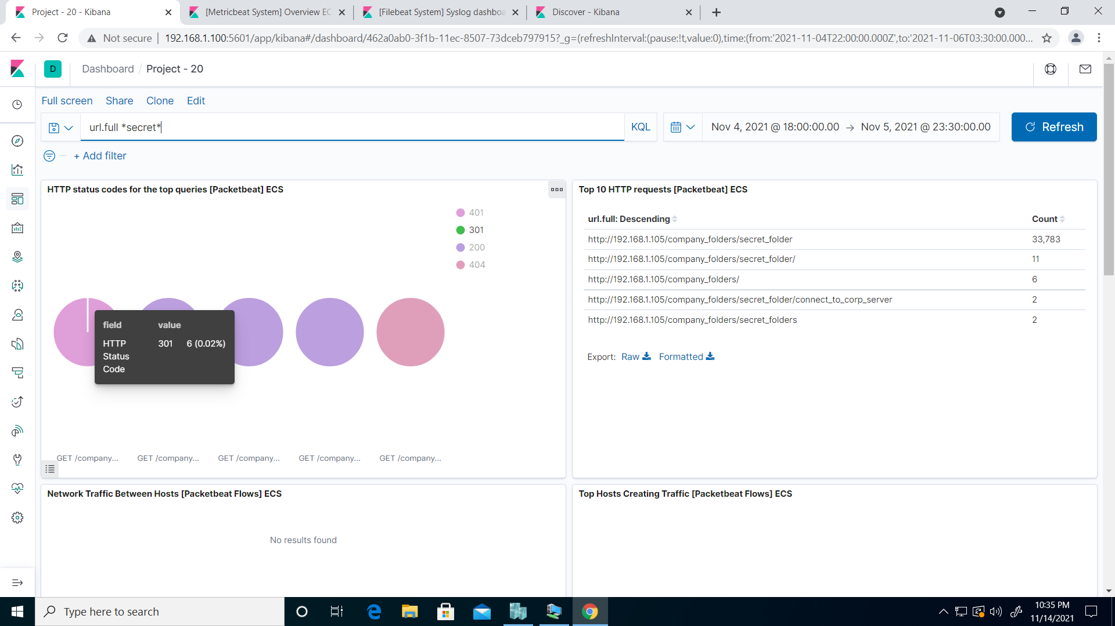
Analysis: Uncovering the Brute Force Attack
Hydra Snapshot
33,783 requests were made in the attack
6 requests made before password was discovered.

Slide 15
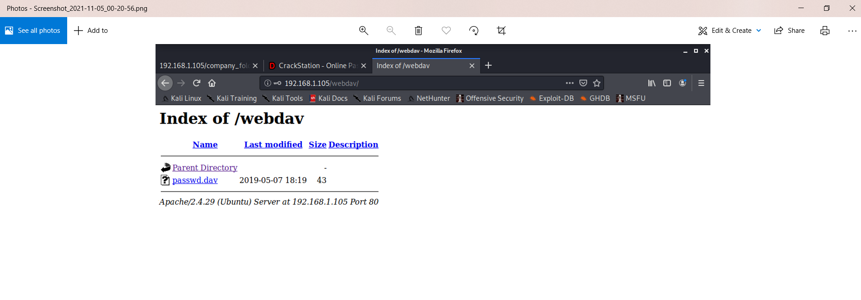
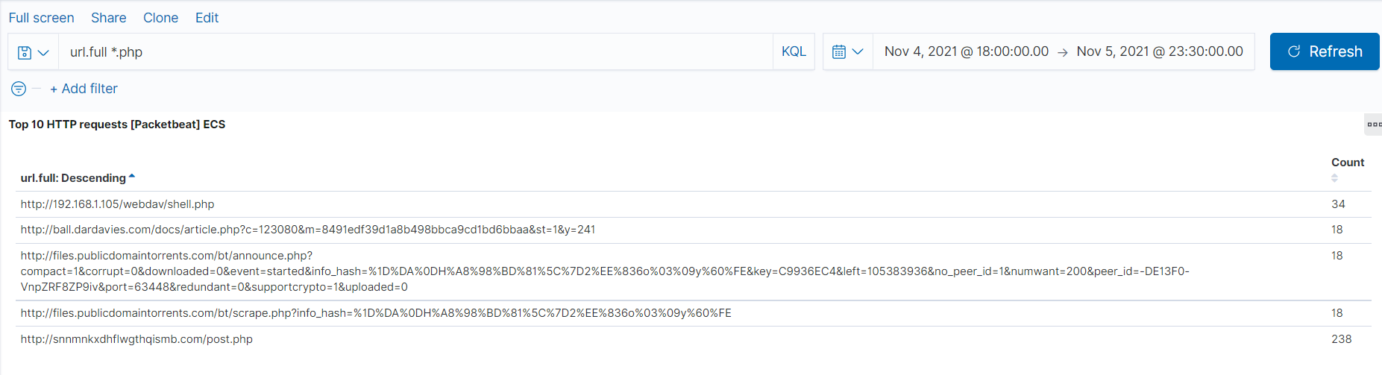
Analysis: Finding the WebDAV Connection
130 requests were made to webdav directory
Shell.php , Passwd.dav was requested.

Slide 16
Blue Team
Proposed Alarms and Mitigation Strategies
‹#›

Slide 17
Mitigation: Blocking the Port Scan
Unauthorized access can be restricted by installing properly configured firewall.
Ports should stay closed , if not in use so that they should be refrained from listening and responding to malicious traffic.
In-house scan should be conducted to see the ongoing behavior within the network , and accordingly should update intrusion detection security rules.
Counting the number of requested ports for each Source IP Address could be subjected to an observation.
A low threshold of 10-15 to maximum of 100 + could be set.

Slide 18
Mitigation: Finding the Request for the Hidden Directory
An alarm could be set for any machine that is attempted to access this hidden directory.
A threshold of single and initial attempt from unauthorized end should be set, so that any suspicious activity be controlled at first step.
To block the unwanted access, files and directories should be encrypted and not available for the public access and thus should be removed from the server.

Slide 19
Mitigation: Preventing Brute Force Attacks
Usage of strong and complicated passwords, changing passwords regularly, avoid dictionary passwords.
Locking accounts after 3 times of incorrect password attempts, this password check could be injected with random pauses . Locking IP addresses with multiple failed logins. (blocking proxy IP addresses)
Adding security questions on top of username and password to login.
Use a CAPTCHA.
Alarm for multiple login attempts could be set.
Secondly, alarm could be created for hydra if discovered in user_agent_original field.
A threshold of 3+ attempts would be legitimate to set.

Slide 20
Mitigation: Detecting the WebDAV Connection
Whenever this directory is accessed by an unauthorized machine would create an alarm.
Threshold could be set to 1.
No access to this shared folder should exist on web server.
Setting firewall rules to restrict its access, and also monitoring on regular basis to update them.

Slide 21
Mitigation: Identifying Reverse Shell Uploads
Restricting .php file uploads by limiting file types.
List of only permitted file extensions should be available on the web server.
Directories that get uploaded should not be allowed to execute and all script handlers should be removed from directories.
A firewall application with regular upgradation should be installed that carries the file filtering process and if in doubt, should discard the file.
Alarm for .php file whenever it is loaded on server.
Alarm for incoming traffic on 4444 port.

